Slide 1

PRESENTATION ON
Digital Video Editing and
Production Systems Images

Slide 2
INTRODUCTION & IMPORTANCE
Art of manipulating and combining video files to create a completed video project.
Method of cutting together film clips, altering and correct sound mixing, add digital effects, and technical changes.
Importance:
Significant impact on the quality of video
Engaging, informative and emotionally resonant

Slide 3
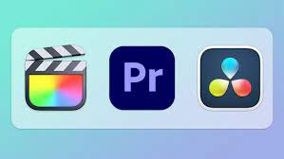
Key Components
Hardware:
High-performance computers
Graphic cards
Storage devices
Software:
Adobe Premiere Pro
Final Cut Pro
DaVinci Resolve
Peripherals:
Cameras, Microphones, External Monitors

Slide 4
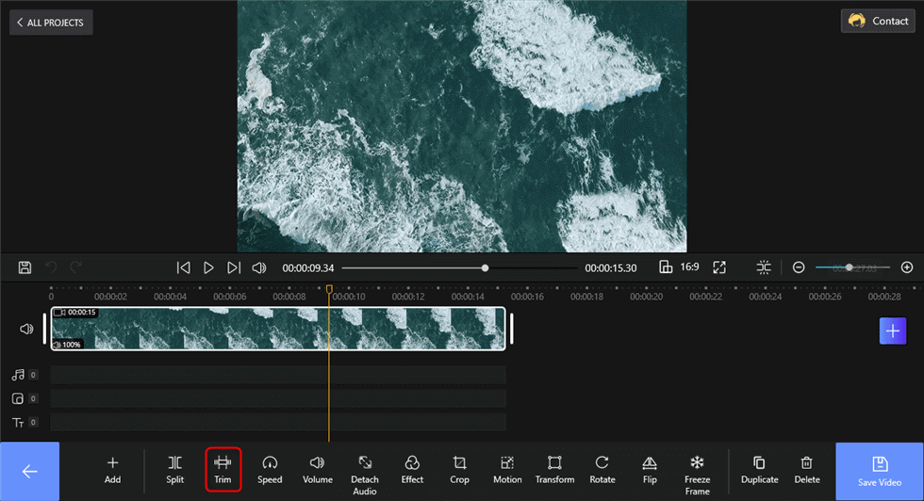
Editing Techniques
Trimming and Cutting Footage
Adding Transitions and Effects
Color Grading and Correction
Special Effects and Animation

Slide 5
Video Production Workflow
A video production workflow refers to the systematic and organized series of steps and processes followed during the creation of a video, from its conceptualization to its final delivery. A well-structured video production workflow ensures that the project is completed within the specified time frame, budget, and quality standards.
The workflow typically includes the following stages:
Pre-Production: Conceptualization, Planning, Pre-visualization
Production: Shooting, Audio Recording, Lighting and Set Design
Post-Production: Video and Audio Editing, Visual Effects (VFX), Color Grading, Distribution

Slide 6
Production Systems
These systems provide a comprehensive set of tools and features tailored for professionals in the film, television, broadcasting, and multimedia industries.
The key aspects related to production systems in video editing are:
Comprehensive Editing Tools
High-Quality Effects and Visual Enhancements
Audio Editing and Mixing Capabilities
Collaborative Work Environment
Integration with Other Software and Hardware
Specialized Features for Film and Television Production
Efficient Rendering and Exporting Options
Technical Support and Training Services

Slide 7
Challenges
Technical Challenges:
Hardware limitations
Software compatibility issues
Troubleshooting common technical problems.
Creative Challenges:
Challenges related to storytelling
Maintaining visual consistency
Engaging the audience effectively.

Slide 8
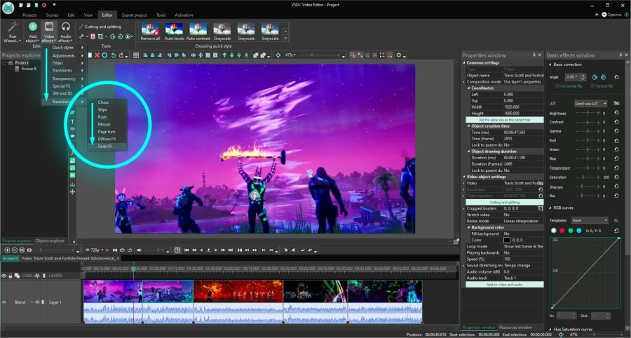
Applications
Film and Television
Advertising and Marketing
Education
Social Media
Corporate Sector
Gaming Industry

Slide 9

Future Trends
Artificial Intelligence and Machine Learning
Virtual Reality (VR) and Augmented Reality (AR) Applications

Slide 10


